Slide 1

Flight Management System

Slide 2
Features of Flight Management System
Easy Addition of Customer, Flight and Bookings
Has Dynamic pricing according to seats and date of departure
Customer can also choose there flight class and food preferences

Slide 3
Development Elements
Made using Java
Concept of OOP Used Properly
Performed JUnit Testing

Slide 4
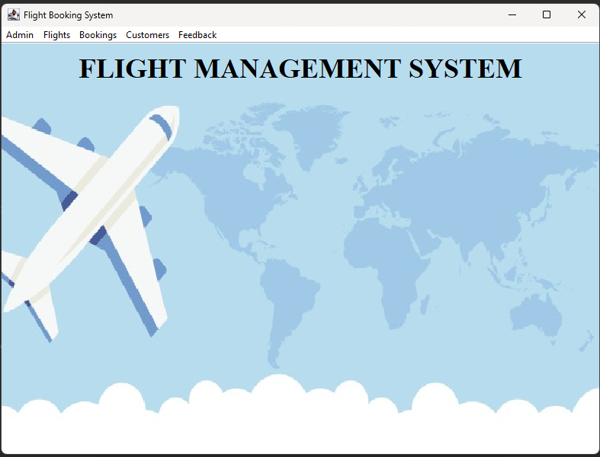
Landing Page of the system

Slide 5
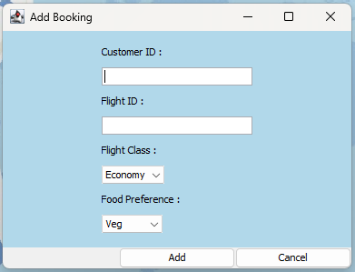
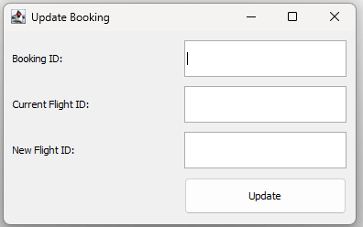
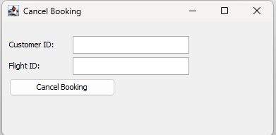
Booking Operations
Add Booking
Update Booking
Cancel Booking

Slide 6
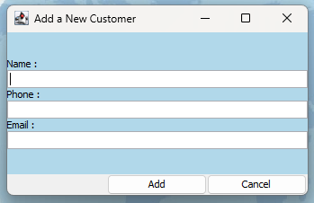
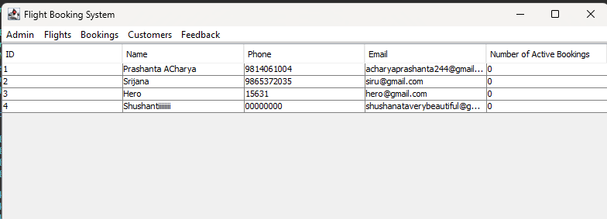
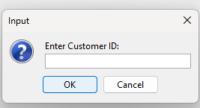
Customers Operations
Add Customers
View Customers
Delete Customer

Slide 7
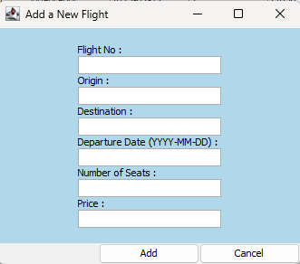
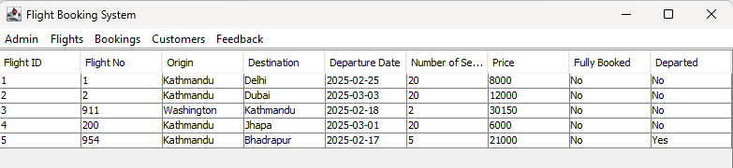
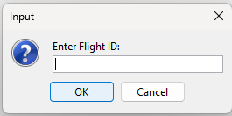
Flight Operations
View Flights
Add Flights
Delete Flight

Slide 8
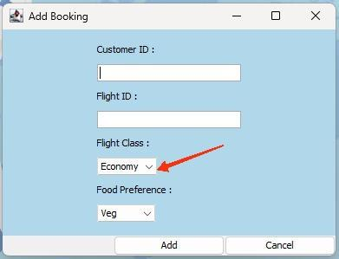
Additional Features
Customer can choose which class they wants to travel. The Economy class has normal price whereas Business class has 10% more than Economy Class

Slide 9
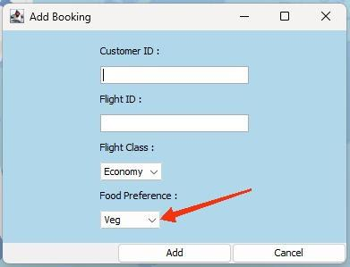
Additional Features
Customers can choose the preferences of food i.e Veg or Non-Veg

Slide 10
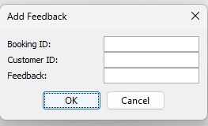
Additional Features
Customers can give feedback for the flights which they have travelled on.

Slide 11


Developed By:
PRASHANTA ACHARYA
SRIJANA SUBEDI

Slide 12


